Slide 1

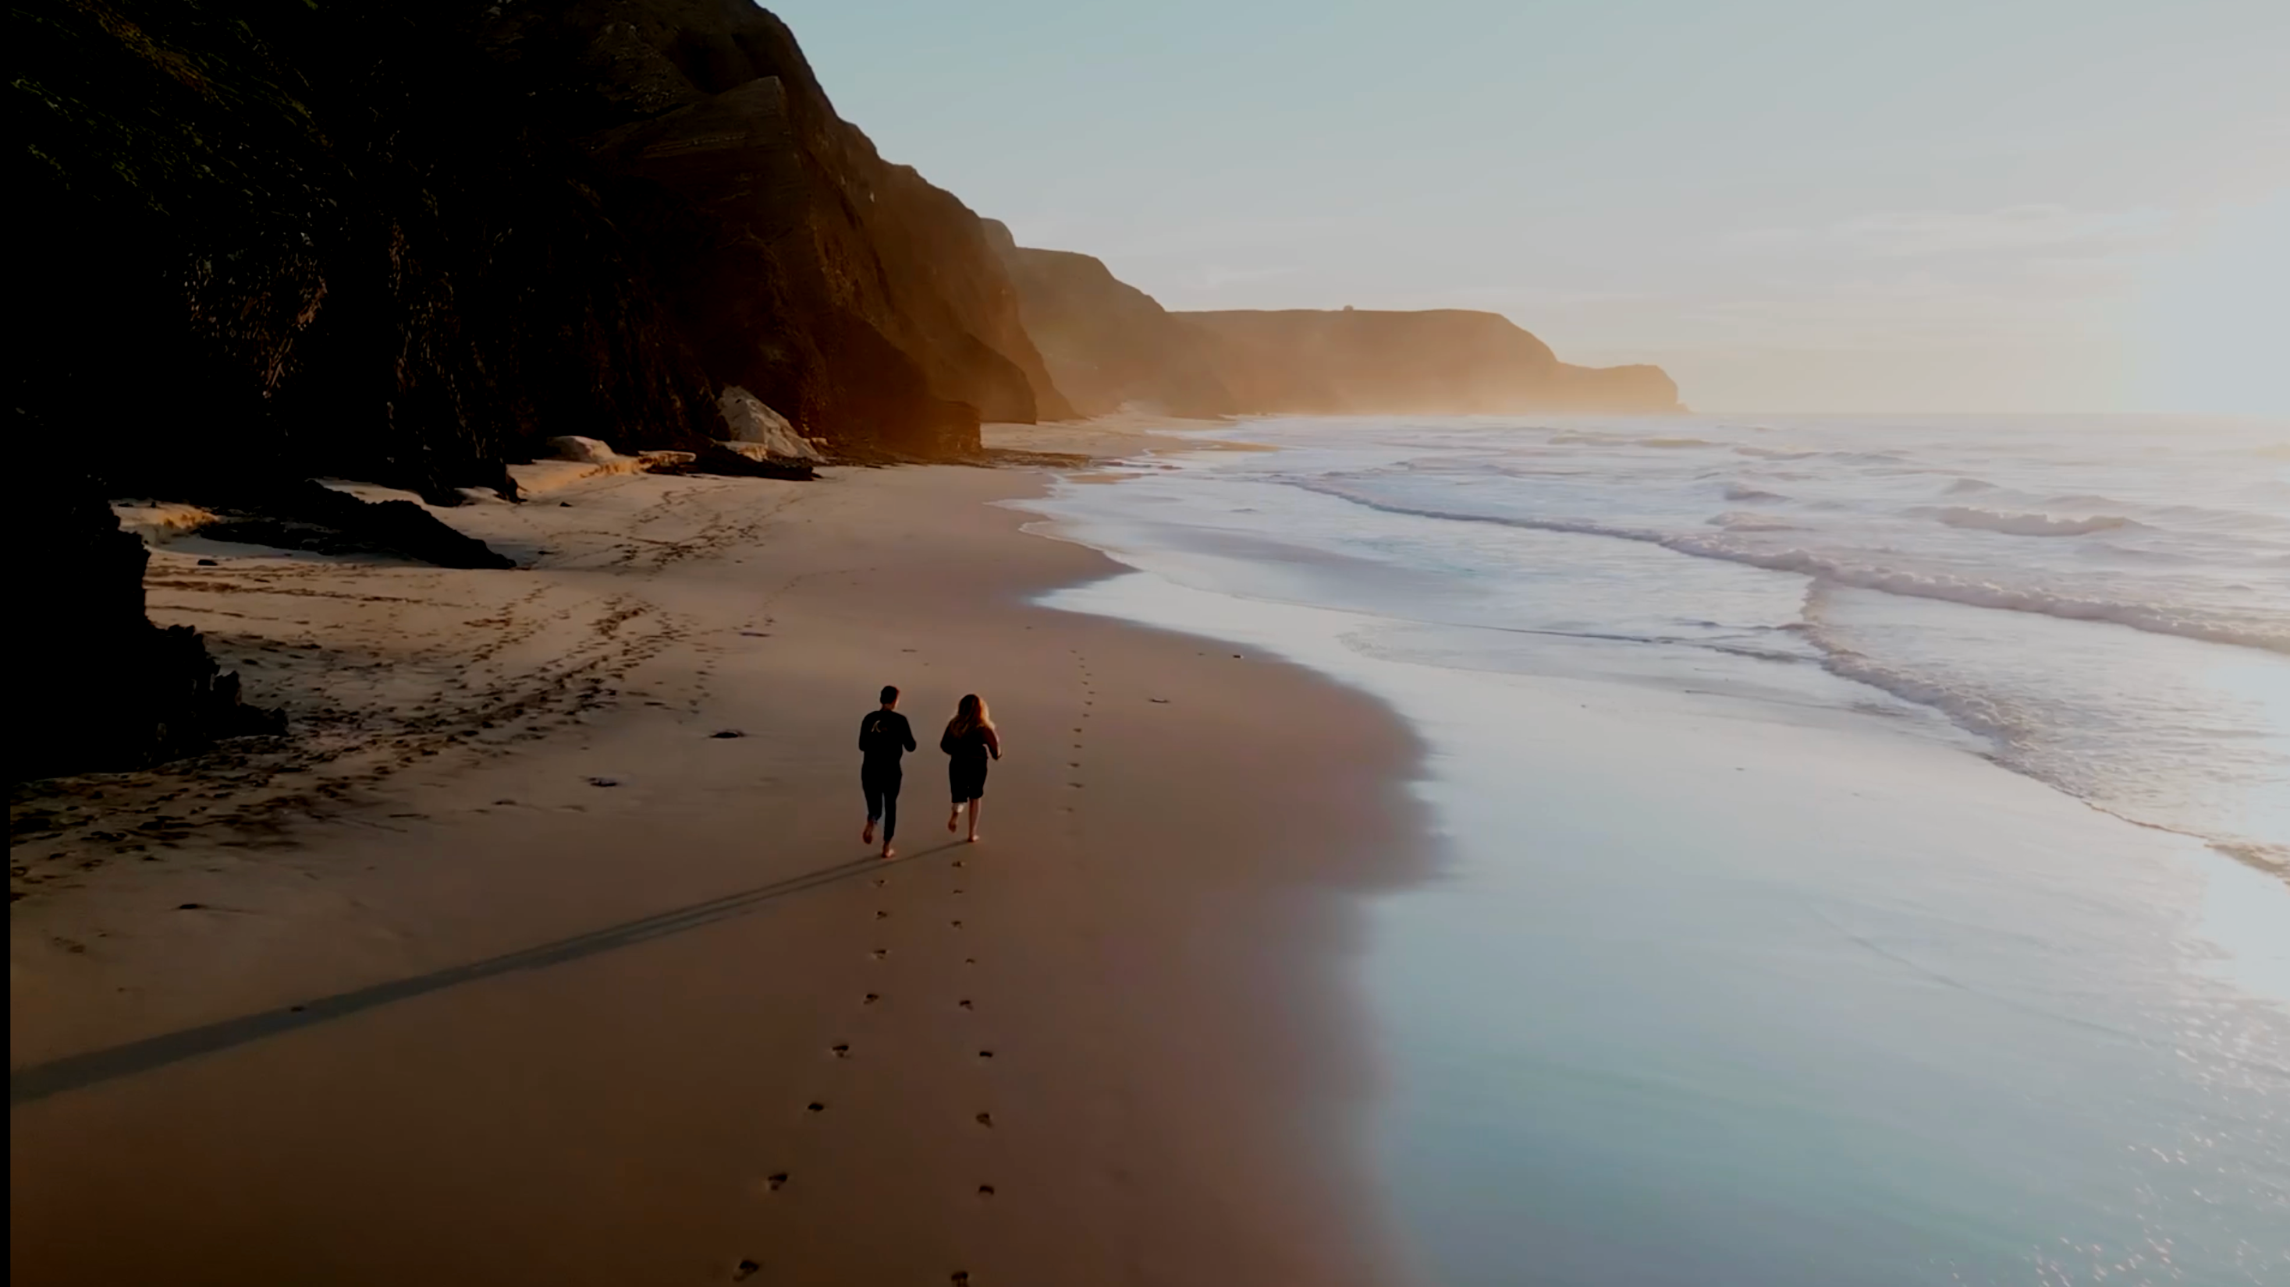

HYMER TARGET GROUP
Travel at the highest level

Slide 2
The communicative target group of HYMER
Task & Objective
The communicative target group defines idealized, prototypical target group profiles of the real target group, which are derived from the profiling fields
of the Hymer brand. It serves as a strategic basis for brand communication.
 | "COMMUNICATIVE" TARGET GROUP | VS. "REAL" TARGET GROUP
Development | Qualitatively designed, based on the brand's strategic profiling areas | Quantitatively determined, based on market research data and target group insights
Presentation | Deliberately exaggerated and idealized to awaken desires and desirability in the real target group | Described factually to provide information about real demographic and behavioral data
Function | Serves to increase brand appeal and identification when addressing the target group | Serves as an objective basis for concrete sales and distribution strategies

Slide 3
The LIMBIC® TYPES
The basis
The Limbic® Types represent the individual emotional personality structures of consumers and serve as the basis for specifying prototypical target group profiles.
In Hymer's primary target group, the "Performers," the dominance system with the hormone testosterone is very pronounced. This foundation drives Performers
to high performance, through which they always want to achieve a special status in society
.
Hymer's secondary target group, the "adventurers," are an experience-oriented, spontaneous target group in search of that special thrill and strive for
freedom and flexibility in their lives.
While performers represent 11 percent of the population in Germany, adventurers are the smallest target group among the Limbic® Types, representing 6 percent.
SECONDARY
TARGET GROUP
HEDONISTS ––– ADVENTURERS ––– PERFORMERS ––– DISCIPLINED ––– TRADITIONALISTS ––– HARMONIZERS ––– OPEN-MINDED ––
6%
PRIMARY
TARGET GROUP
13
11
LIMBIC®
TYPES
12
12%
28
18
Source: Limbic Types (Gruppe Nymphenburg)

Slide 4
#premium360
Our company's ambition
We are genuinely
inspiring.
We are truly
consistent.
We create long-term
(added) value in the long term.
We are
cooperative.
Like no other, we not only understand the desires and needs of our target group, but also share their passion for mobile travel.
With enthusiasm, we create
inspiring premium
experiences without compromise.
We convince every day anew through consistency in
our thinking and actions.
We are committed to our high standards with perseverance
to our high standards in order to exceed our customers' expectations at every contact and at all times.
Nothing we do is for short-term effect, but for what
creates long-term value: memorable travel experiences for our customers. Sustainable profitability for our company. Genuine identification among employees and partners.
In order to meet our standards of quality, innovation, and profitability, we cultivate an appreciative and cooperative partnership—both in our exchanges with our customers and with our colleagues and partners.

Slide 5
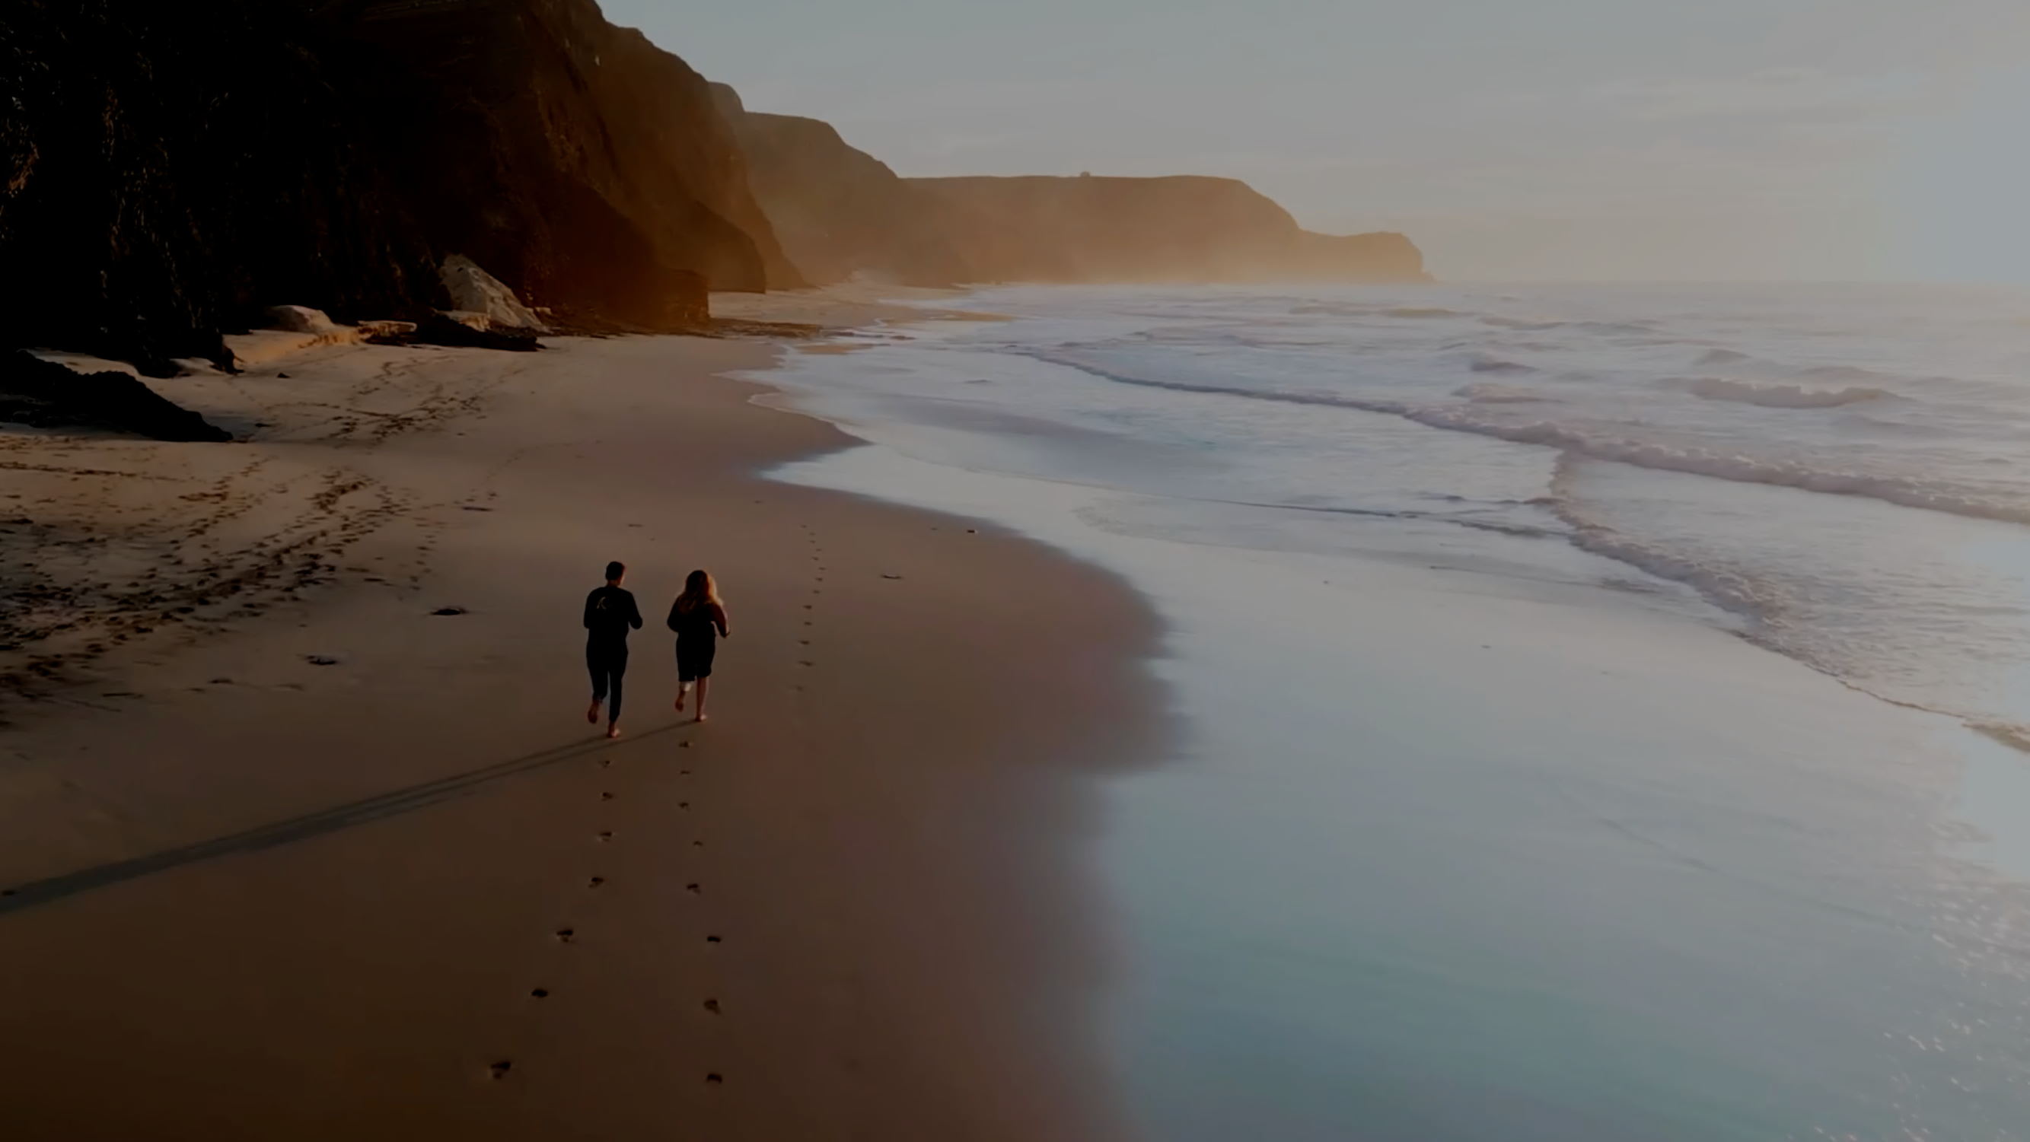

The premium experience from Hymer
#EXPLORE
PURE
PREMIUM
With excellent motorhomes, camper vans, services, and accessories
, we are the first choice for discerning people who
who expect unique experiences without compromise .
.

Slide 6
The Hymer brand promise
Reliability
SHAPING
PERFECTION
FLEXI-TRAVELER
OFF-TRAIL SEEKER
PRESTIGE VOYAGER
SMART ACTIVE
#EXPLORE
PURE
PREMIUM
UNCOMPROMISING
COMFORT
Pure
ambition
PERFORMANCE
PLEASURE
MOVING
SOVEREIGNTY
Flexibility

Slide 7
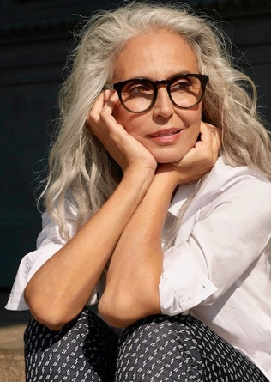
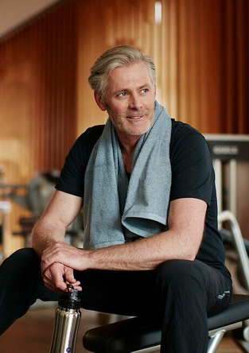
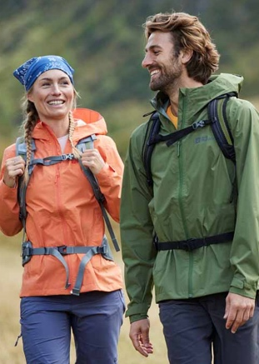
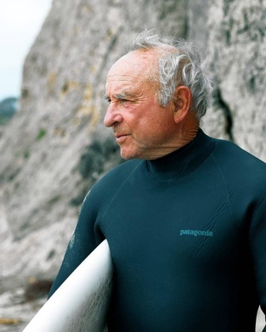
OVERVIEW
The communicative target groups
Reliability
For this performance-oriented target group, exercise is part of the journey. They love athletic challenges and plan their travel activities with precision. Smart solutions are essential.
This target group naturally associates travel with comfort. They value high-quality experiences and reliable service. People who don't want to miss out on the feeling of luxury when they are on the move.
SHAPING
PERFECTION
FLEXI-TRAVELER
OFF-TRAIL SEEKER
PRESTIGE VOYAGER
SMART ACTIVE
#EXPLORE
PURE
PREMIUM
UNCOMPROMISING
COMFORT
Pure
ambition
PERFORMANCE
PLEASURE
Whether it's short urban trips or spontaneous outdoor activities – this target group values compact solutions that
offer maximum flexibility.
Ideal for anyone looking for an uncomplicated yet comfortable way to travel.
Independent and spontaneous:
This target group avoids the beaten track. Time spent in nature is top priority for them.
They actively experience the outdoors actively with innovative equipment.
MOVING
SOVEREIGNTY
Flexibility

Slide 8
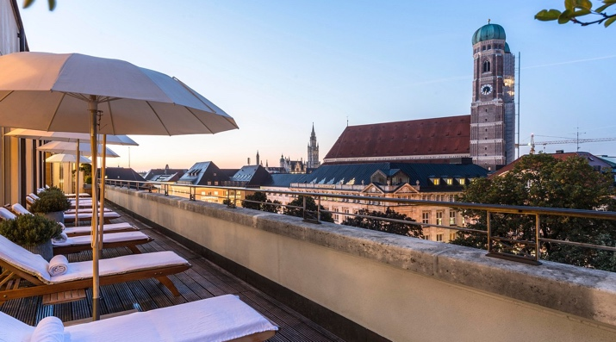
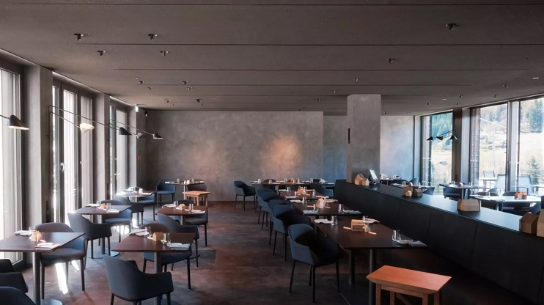
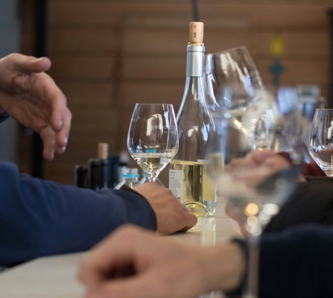
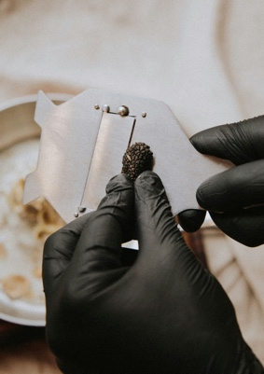

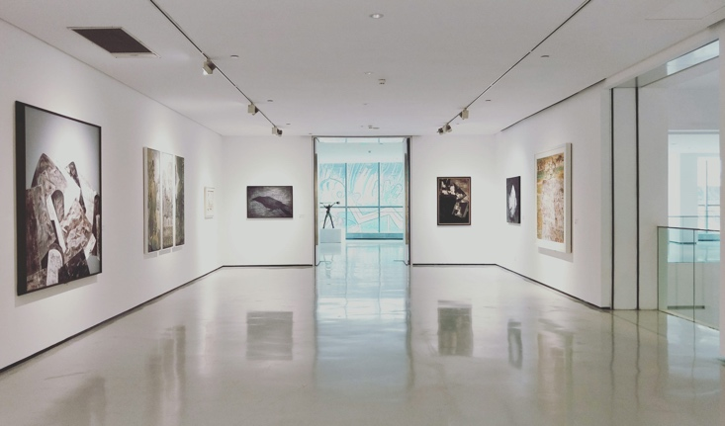
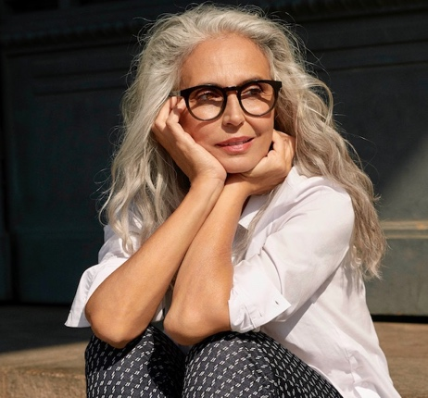
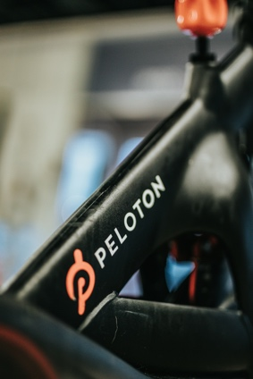

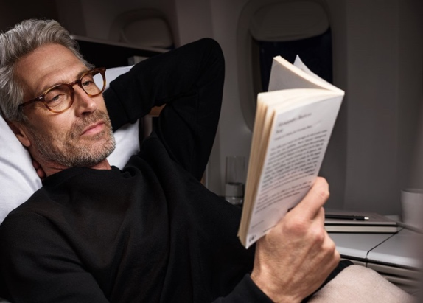
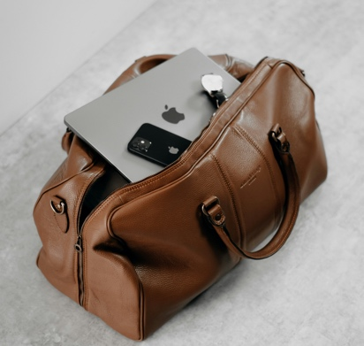
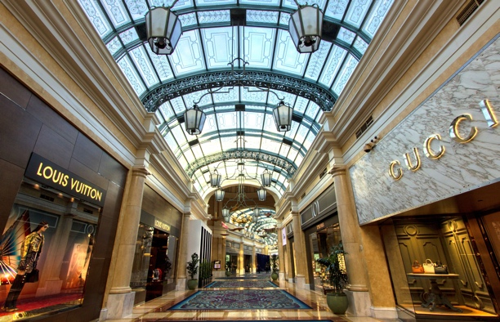
The PRESTIGE voyager
Profile
This target group naturally associates travel with comfort. They value high-quality experiences and reliable service. People who don't want to miss out on the feeling of luxury even when they are on the move.
.
Characteristics
Leitmotiv (for mobile travel) | RELIABILITY & PLEASURE
Affinity (interests) | Visits to exclusive resorts, luxury spa experiences, gourmet dining, curated selections of museums, exhibitions, and galleries, wine culture, classic cars, interior design, cruises
Profiling (Differentiation) | Connoisseurship (quality & tradition), exclusivity, self-confidence/sovereignty, individuality, curation
Community (identification) | including American Express Black Card Community, Lufthansa Hon-Circle, Michelin Guide, opera subscription, golf club
(Brand) world (Lifestyle) | including Mercedes Benz, Montblanc, Bang & Olufson, Louis Vuitton, Burberry, Manufactum, Dallmayr, Condé Nast Traveller, AD
8

Slide 9
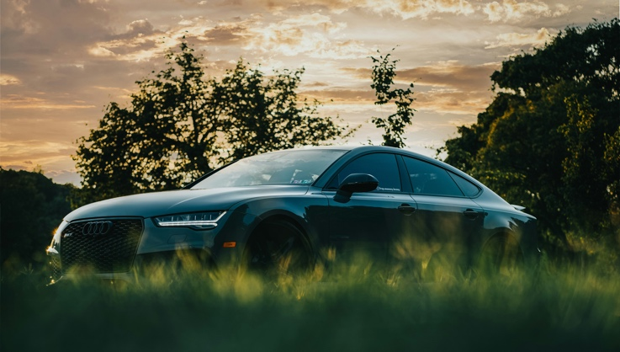
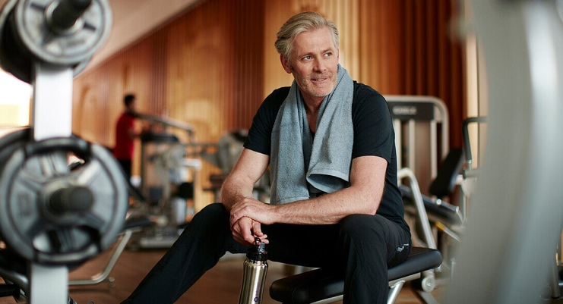
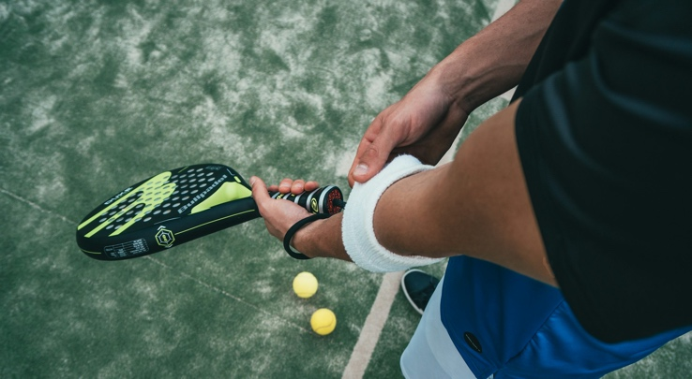
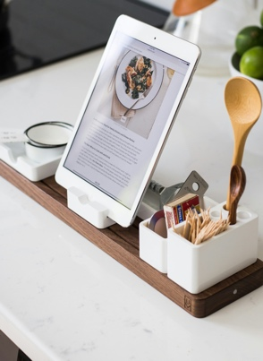
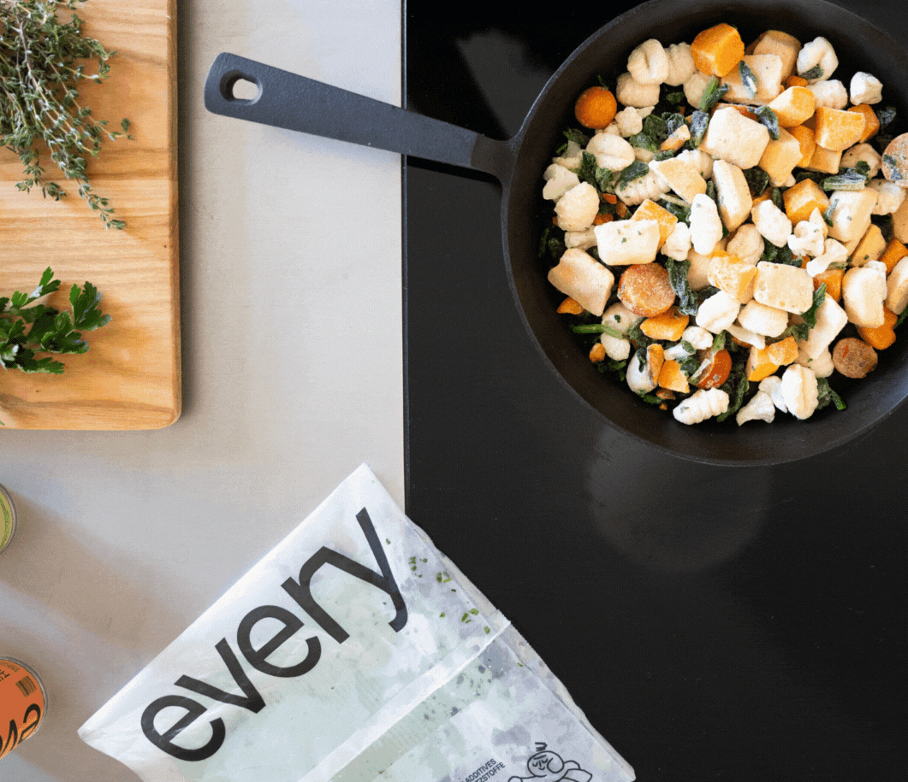
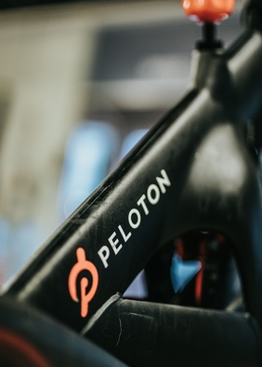
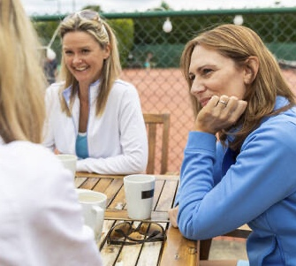
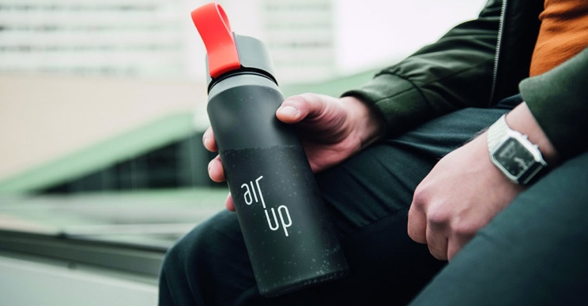
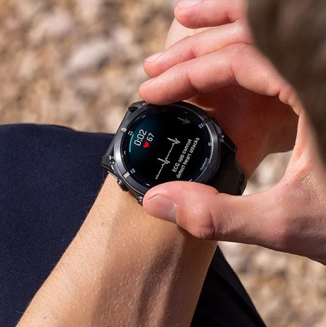


The smart active
Profile
For this performance-oriented target group, exercise is part of the journey.
They love athletic challenges and plan their travel activities with precision. Smart solutions are essential.
Characteristics
guiding principle (for mobile travel) | RELIABILITY & PERFORMANCE
Affinity (interests) | Individual sports (skiing, running, tennis, windsurfing, diving) and sporting events Advice, technology, cooking, financial planning/insurance
Profiling (Distinction) | Participation in half marathons, nutritional awareness, home ownership, technical gadgets
Community (identification) | Peleton, Facebook, Garmin, tennis club, Every Foods
(Brand) world (Lifestyle) | including Peleton, Allianz, Orthomol, Garmin, Samsung, Audi, Cube
9

Slide 10
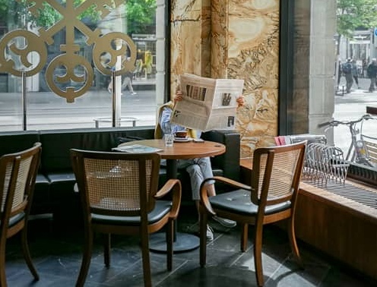
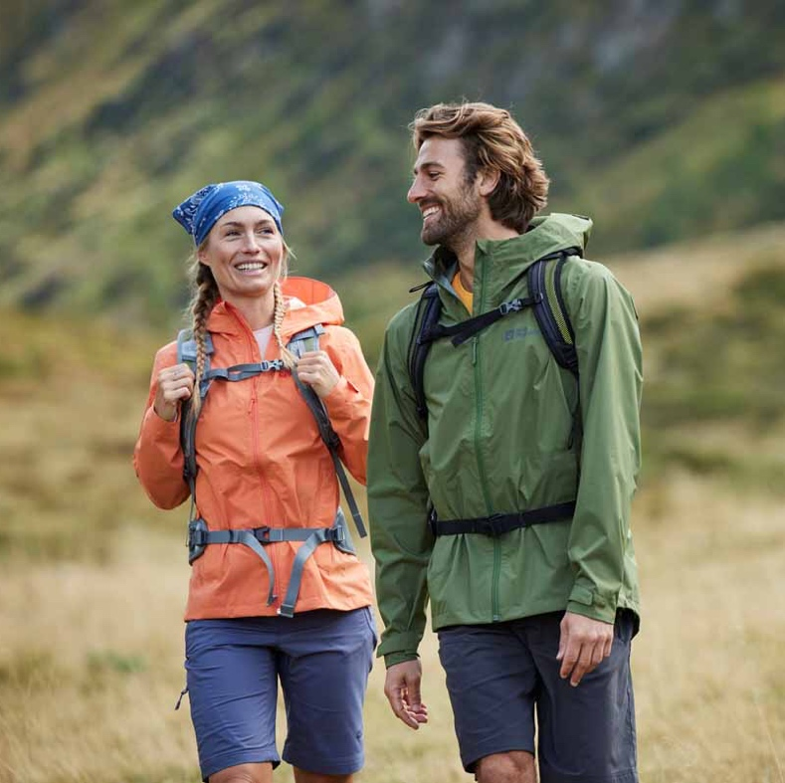
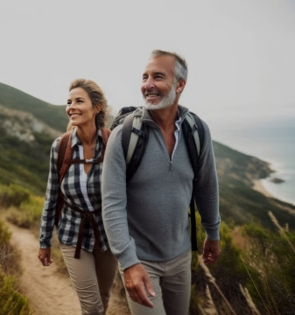
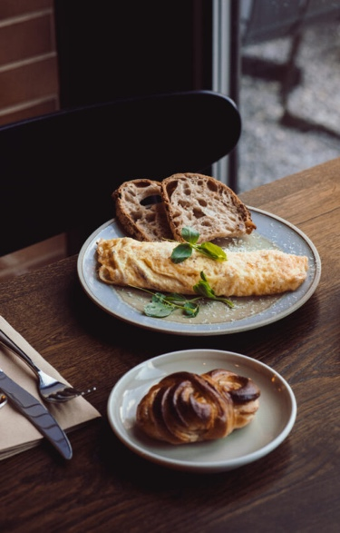
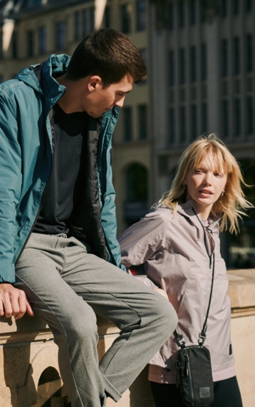
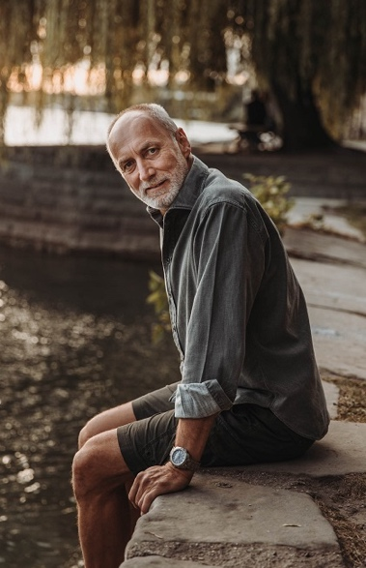

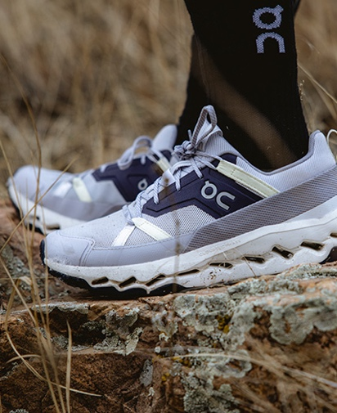
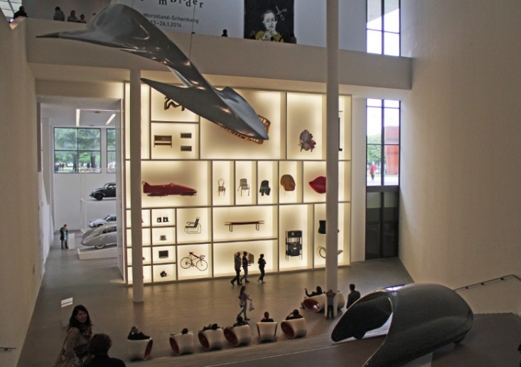
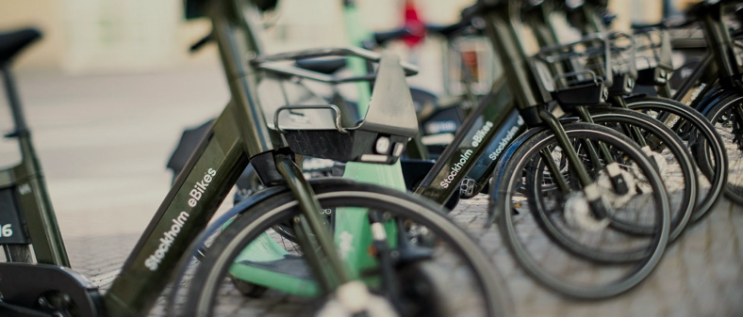
The AGILE traveller
Profile
Whether for short urban trips or spontaneous outdoor activities, this target group values compact solutions that offer maximum flexibility. Ideal for anyone who are looking for an uncomplicated yet comfortable way to travel.
Characteristics
Leitmotiv (for mobile travel) | PLEASURE & FLEXIBILITY
Affinity (interests) | Art, culture & architecture, concerts, cooking classes, hiking, swimming, nature & animals, readings, photography
Profile (Distinction) | Variety, multifunctionality, versatility, travel reports, value for money, sociability (family & friends)
Community (Identification) | Including Süddeutsche subscription, self-organized travel group with varied activities
(Brand) world (Lifestyle) | including Decathlon, Jack Wolfskin, AirBnB, Arte, Spiegel bestsellers, Canon/Nikon, On Cloud, Amazon Kindle
10

Slide 11
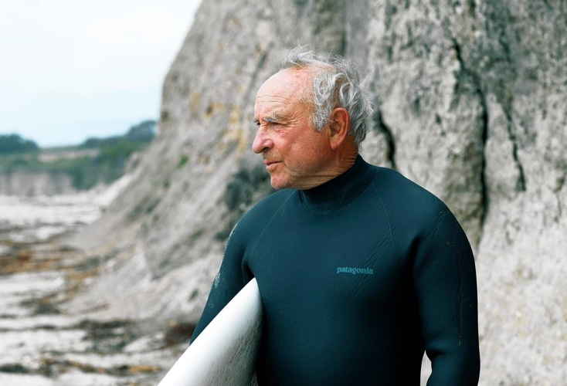
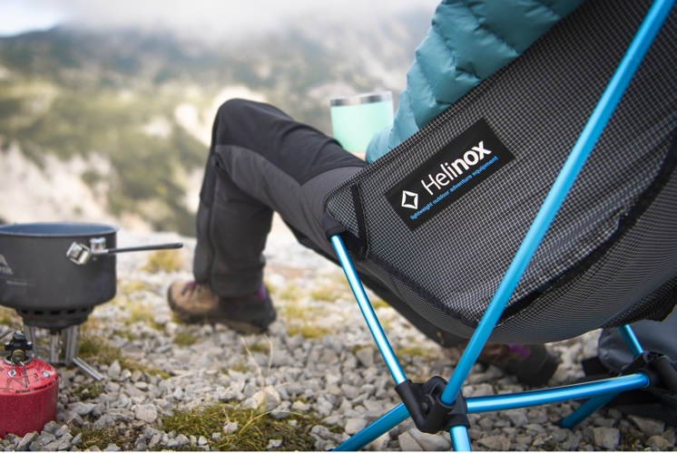


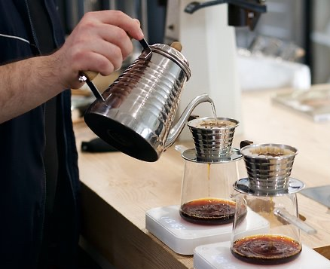

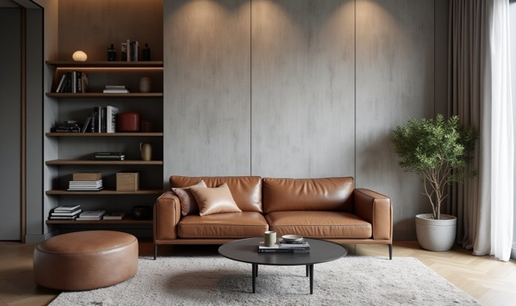
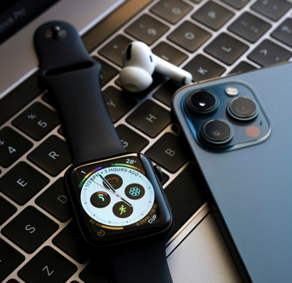
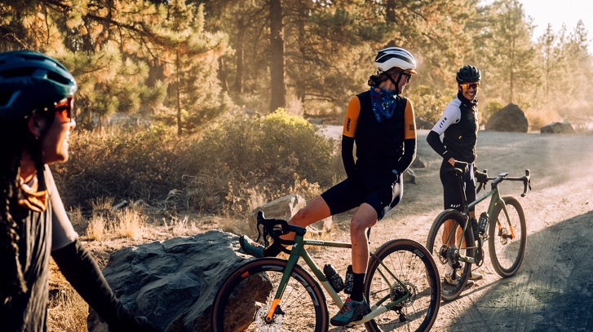
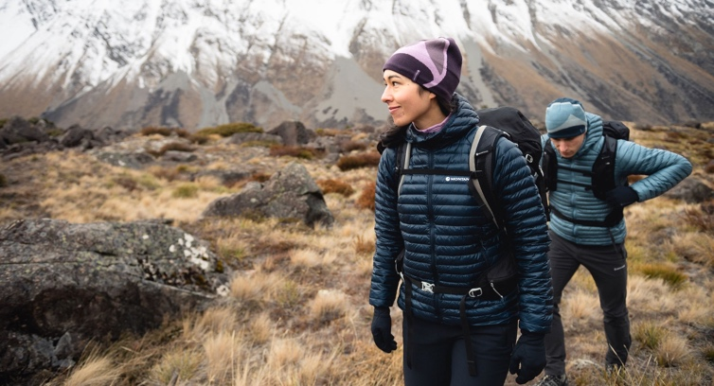
The off-trail
SEEKER
Profile
Independent and spontaneous: this target group avoids the beaten track.
Spending time in nature is their top priority. They actively experience the outdoors actively with innovative equipment.
Characteristics
Leitmotiv (for mobile travel) | PERFORMANCE & FLEXIBILITY
Affinity (interests) | (Trend) sports such as ski touring, kite surfing, paragliding, diving, gravel biking, coffee culture, natural phenomena (including the Northern Lights and solar eclipses)
Profiling (Differentiation) | Personal & financial independence, innovation (early adopter), management & leadership, intellect, technology
Community (Identification) | Bergwelten, Alpen Verein, Skiline, Strava, LinkedIn, OMR, among others
(Brand) world (Lifestyle) | Apple, Patagonia, Canada Goose, Helinox, Outdoor Film Festival, among others
11

Slide 12
Product communication
Possible approaches for target group-specific orientation
Reliability
BML
SHAPING
PERFECTION
ML-T
FLEXI-TRAVELER
OFF-TRAIL SEEKER
GTS
BMC
PRESTIGE VOYAGER
SMART ACTIVE
Grand Canyon S
#EXPLORE
PURE
PREMIUM
UNCOMPROMISING
COMFORT
Pure
ambition
PERFORMANCE
PLEASURE
Venture S
ML-T 4x4
Cross Over/Cross Trail
Redwood
Grand Canyon S 4x4
Cross Over/Cross Trail
Yellowstone (Fiat CV)
MOVING
SOVEREIGNTY
Exsis
Flexibility

Slide 13
EXPLORE PURE PREMIUM

